Slide 1

UNIVERSITY SUCCESS ANALYSIS

Slide 2


Slide 3
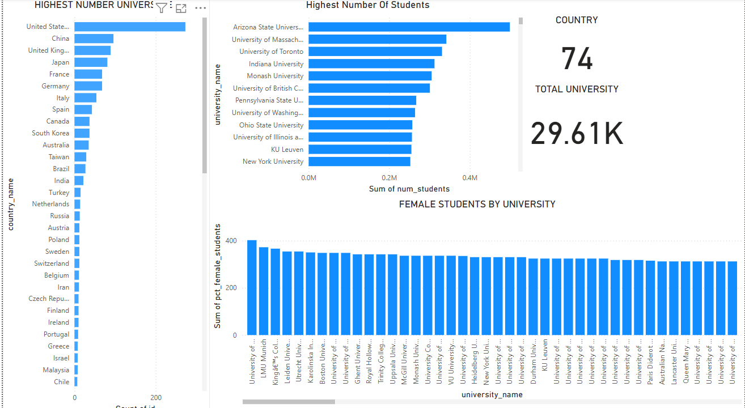
COUNTRY ANALYSIS

Slide 4
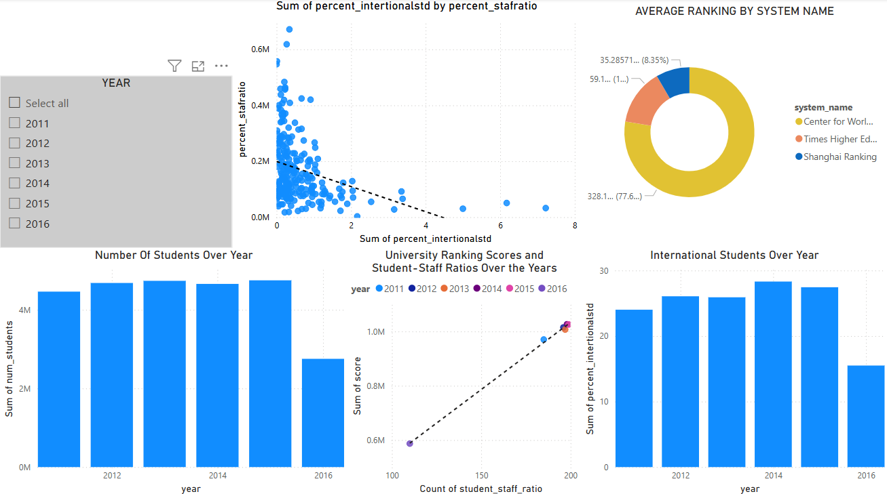
UNIVERSITY ANALYSIS

Slide 5
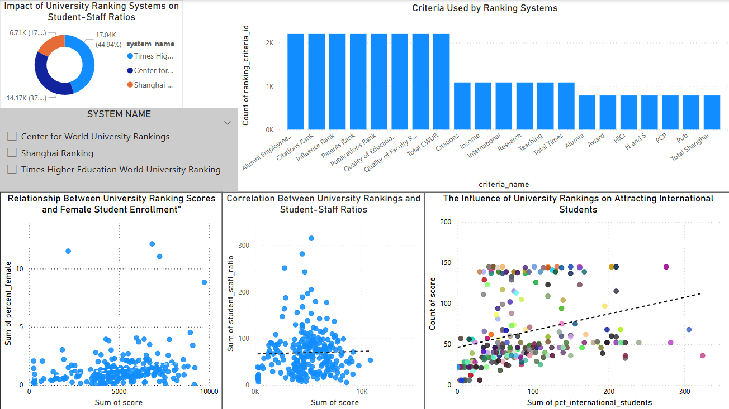
RANKING SYSTEM ANALYSIS

Slide 6
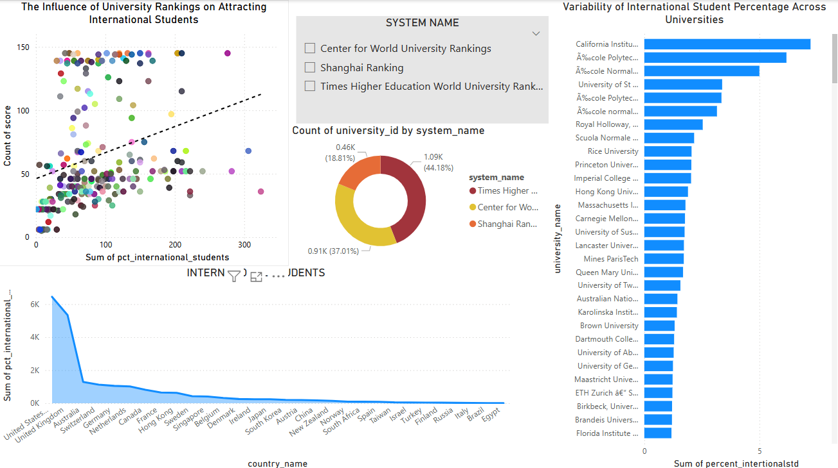
INTERNATIONAL STUDENTS ANALYSIS

Slide 7
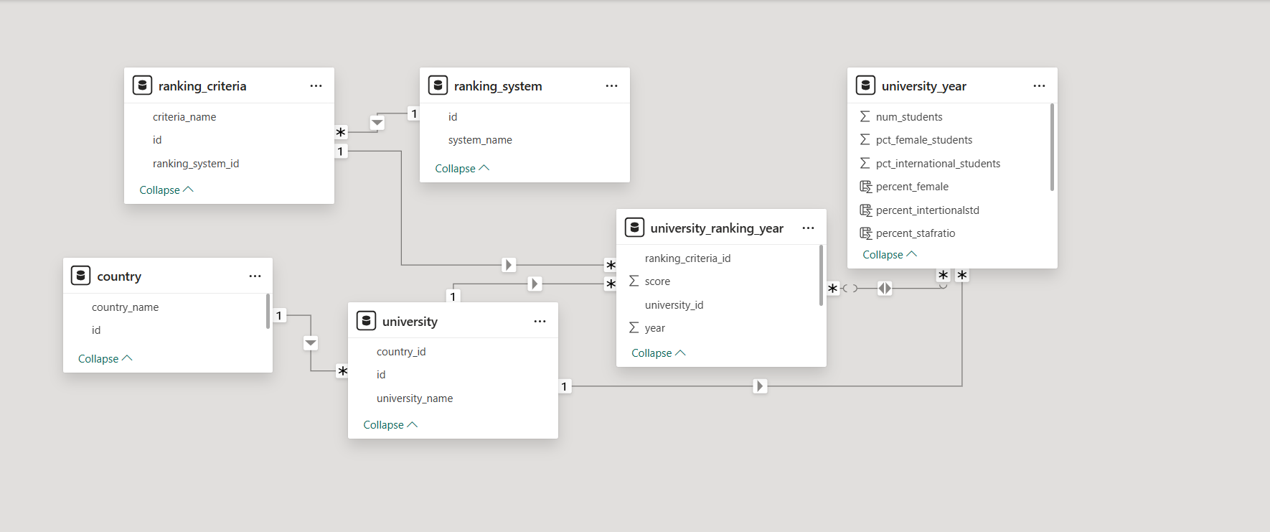
ER Diagram

Slide 8

Power Bi Problem Statements

Slide 9
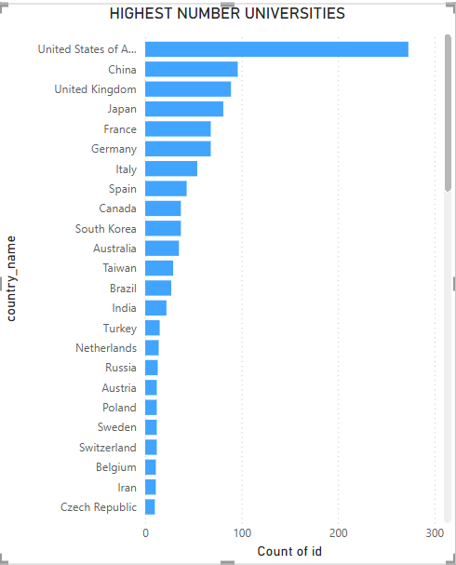
How many universities are there in each country
The United States has the highest number of the Universities, followed by China, the United Kingdom, Japan, and other countries.
Qatar,Serbia,Uganda and Uruguay has the least Number of Universities.

Slide 10
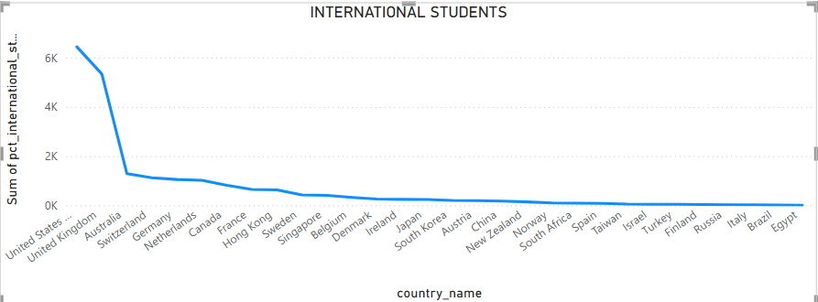
What is the distribution of international students across different countries
The United States has the highest number of international students, followed closely by the United Kingdom and Australia.
Egypt, Brazil, Italy, and Russia appear to have the lowest numbers of international students.

Slide 11
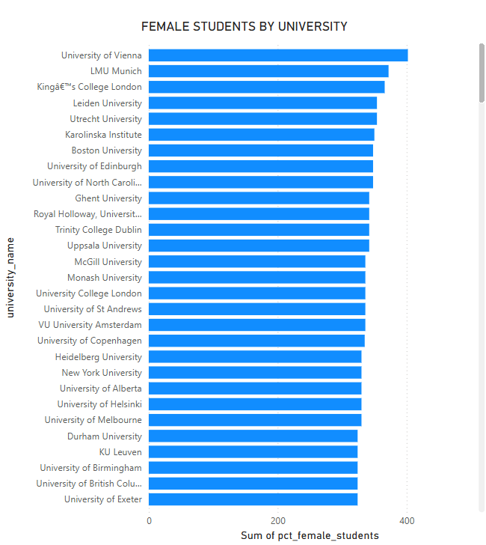
Which country has the highest number of female students enrolled in universities
Austria (University of Vienna) appears to have the highest count.
Germany (LMU Munich) also has a significant number.
The United Kingdom, Netherlands, and Sweden also have multiple universities with high female enrollment.
Mines Paris Tech and National Chiao Tung Universities has the Lowest count of female students.

Slide 12
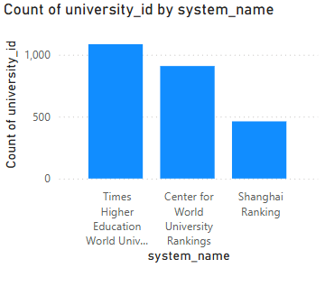
How many universities are ranked by each ranking system
The chart shows the number of universities ranked by three global ranking systems. Times Higher Education (THE) ranks the most universities (over 1,000), followed by Center for World University Rankings (CWUR) (around 900). Shanghai Ranking (ARWU) ranks the least, under 500, likely due to its focus on research output. This indicates differences in ranking criteria and coverage among these systems.

Slide 13
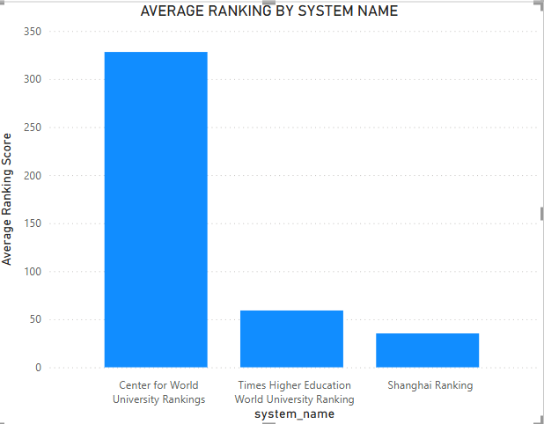
What is the average score for universities according to each ranking system.
Center for World University Rankings (CWUR): Around 330
Times Higher Education (THE) World University Ranking: Around 60
Shanghai Ranking (Academic Ranking of World Universities - ARWU): Around 40

Slide 14
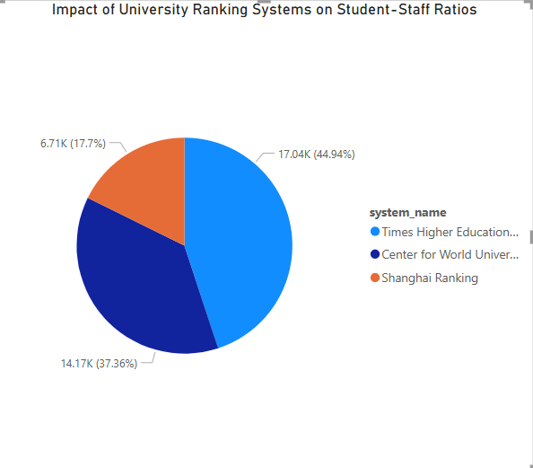
How does the ranking system affect a university's student-staff ratio
Times Higher Education (THE) – 44.94% (Largest Share).
THE-ranked universities focus more on teaching quality, leading to lower student-staff ratio.
Center for World University Rankings (CWUR) – 37.36%.
CWUR-ranked universities have a balanced approach between teaching and research.
Shanghai Ranking (ARWU) – 17.7% (Smallest Share)
ARWU-ranked universities prioritize research output, often resulting in a higher student-staff ratio.

Slide 15
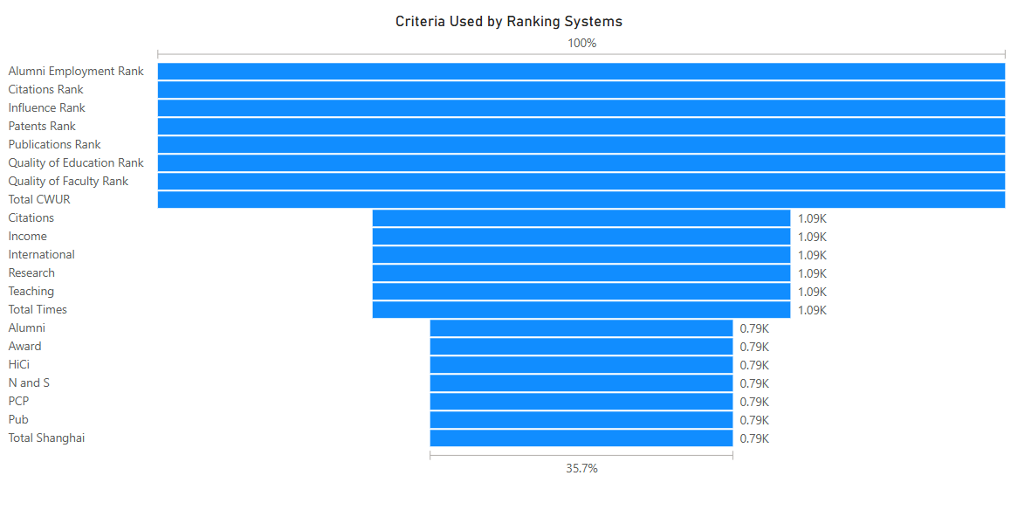
What are the most important criteria considered by ranking systems
Research Impact (Citations, Publications, Patents) is the most critical factor in university rankings.
Alumni Success and Employment play a crucial role in reputation-based rankings.
Faculty Quality and Education Standards significantly affect rankings.
Shanghai and Times Rankings emphasize research, while CWUR balances multiple factors.

Slide 16
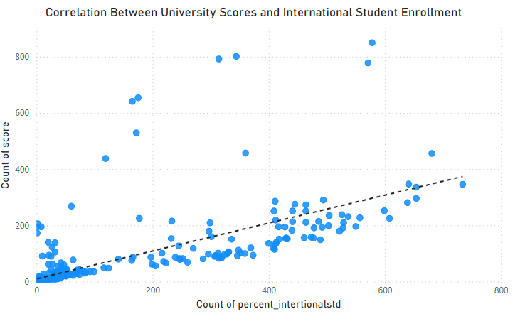
Is there a correlation between a university's score and the number of international students
The scatter plot with a trend line suggests a positive correlation between a university's score and the percentage of international students. As the number of international students increases, the university's score also tends to rise.

Slide 17
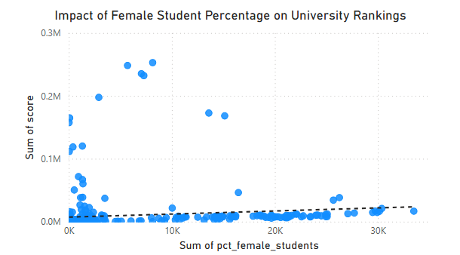
How does the percentage of female students impact a university's ranking
The analysis suggests a weak correlation between the percentage of female students and a university's ranking. The scatter plot indicates that while some universities with high scores have a notable percentage of female students, the overall distribution does not show a strong trend. This implies that other ranking factors, such as research output, faculty quality, and funding, may have a greater impact on rankings than gender diversity alone

Slide 18
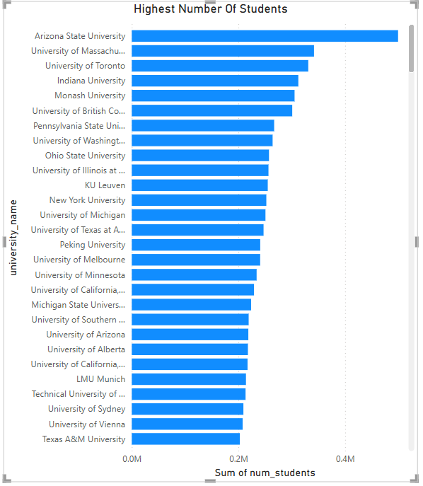
Which university has the highest number of students
Arizona State University has the highest number of students among the listed universities. It has a significantly higher student population compared to the others.
University of Massachusetts second-largest student population among the listed universities.

Slide 19
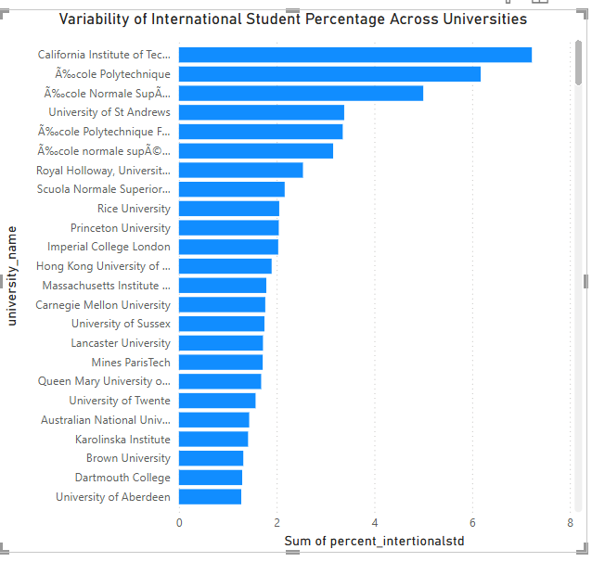
How does the percentage of international students vary across different universities
California Institute of Technology has the highest percentage of international students.
École Polytechnique and École Normale Supérieure also have a high percentage of international students.
University of Safo Paulo and Alexandria University has the lowest percentage of international students.

Slide 20
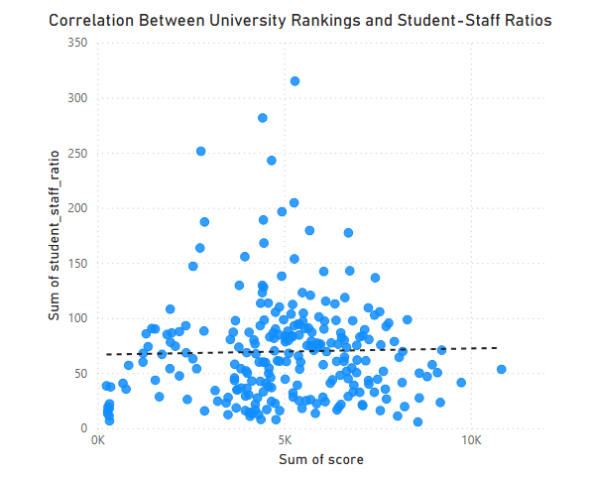
Is there a correlation between a university's ranking and its student-staff ratio
The scatter plot illustrates the relationship between university rankings (represented by scores) and student-staff ratios. From the visualization, there appears to be no strong correlation between these two variables. The distribution of points is widely scattered, and while there is a slight trend suggesting that higher-ranked universities (higher scores) tend to have lower student-staff ratios, the relationship is not definitive.

Slide 21
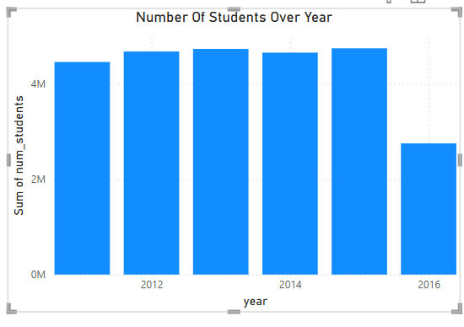
How does the number of students in universities change over time?
2011-2015: The number of students shows a steady increase, indicating growth in university enrollment.
2016: There is a sharp decline in student numbers compared to previous years.
This drop in 2016 could be due to various factors, such as changes in admission policies, economic conditions, government regulations, or shifts in student preferences.

Slide 22
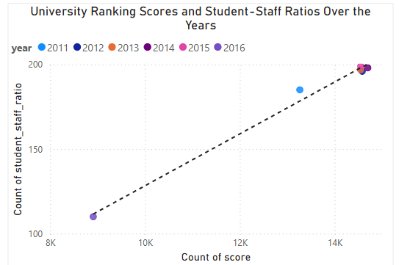
Is there a correlation between a university's ranking score and the student-staff ratio over the years
The scatter plot suggests a strong positive correlation between a university’s ranking score and its student-staff ratio over the years. As the total ranking score increases, the student-staff ratio also rises proportionally. This indicates that universities with higher overall ranking scores tend to have a greater number of students per staff member, which may reflect changes in faculty availability, institutional expansion, or shifts in ranking criteria over time.

Slide 23
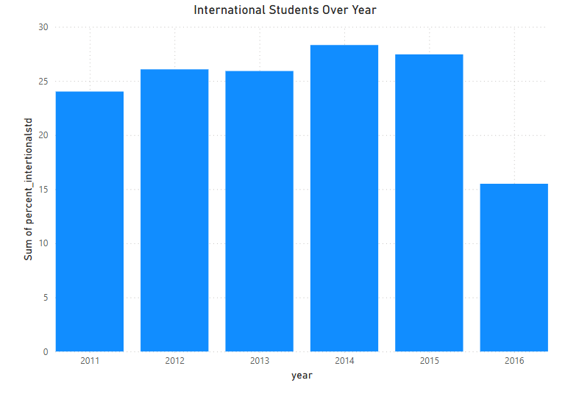
How does the percentage of international students vary across different years
2011: Around 24-25%
2012: Slight increase to around 26%
2013: Remains stable at around 26%
2014: Peaks at approximately 29%
2015: Slight decrease to around 28%
2016: Significant drop to around 15%

Slide 24
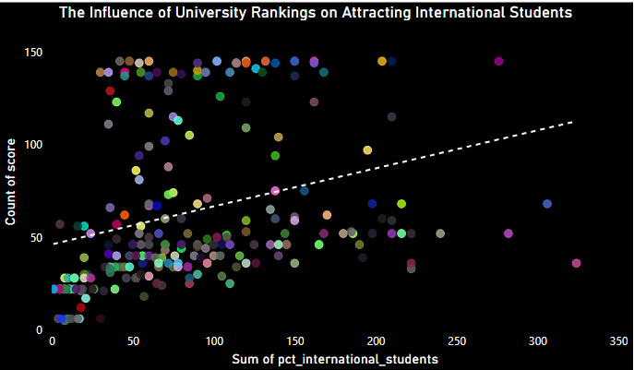
What is the impact of a university's ranking on the number of international students it attracts
The analysis suggests a positive correlation between a university’s ranking score and the number of international students it attracts. Higher-ranked universities tend to enroll more international students, likely due to their global reputation, better academic resources, and enhanced career prospects.

Slide 25
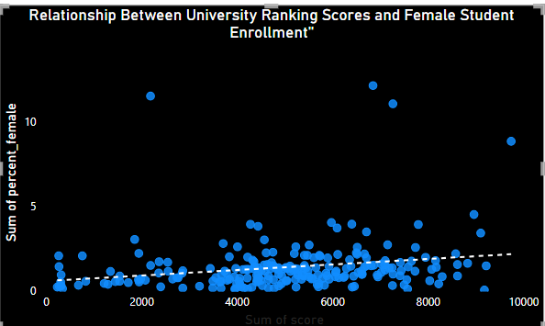
Is there a relationship between a university's ranking score and the percentage of female students enrolled
The relationship between a university's ranking score and the percentage of female students is Positive weak, meaning other factors likely play a more significant role in female enrollment.

Slide 26
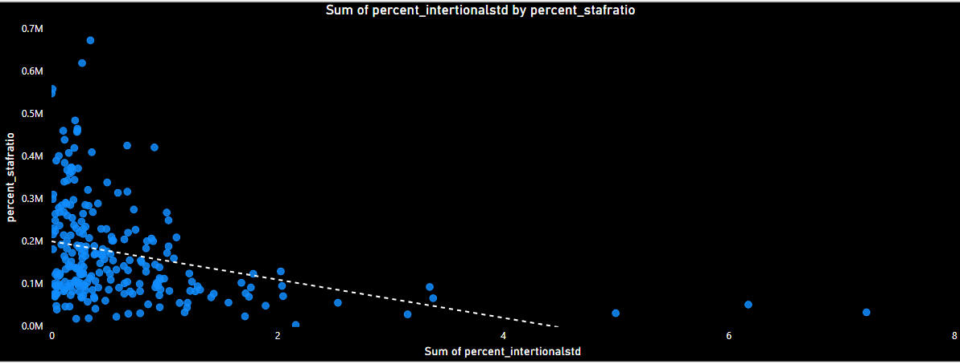
How does the percentage of international students affect a university's student-staff ratio
Downward trend: The dashed regression line slopes downward, indicating that as the percentage of international students increases, the student-staff ratio tends to decrease.
Higher student-staff ratios at lower international student percentages: Most data points cluster towards the left, where universities with a lower percentage of international students tend to have higher student-staff ratios.
Lower student-staff ratios for universities with more international students: As the percentage of international students increases, the student-staff ratio generally declines, meaning there are fewer students per staff member.

Slide 27
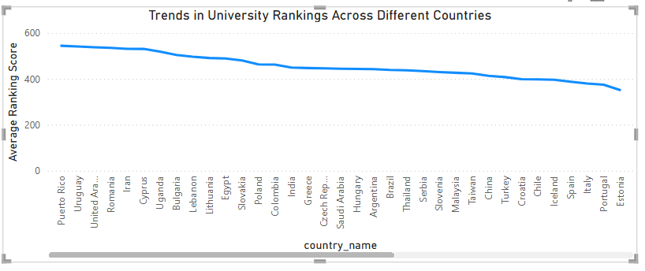
Are there any significant trends or patterns in the rankings of universities from different countries
Countries with strong economies and well-established education systems (e.g., the US, UK, Canada, Switzerland, Netherlands, Germany) tend to have better-ranked universities.
Many developing countries (e.g., Iran, Bulgaria, Lebanon, Egypt) tend to have universities ranked lower on average.
Countries like China, Singapore, Japan, and South Korea have competitive rankings, showing their growing presence in higher education.

Slide 28

EDA Problem Statements

Slide 29
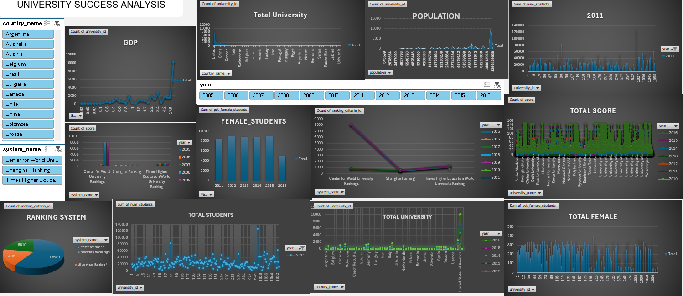
DASHBOARD

Slide 30
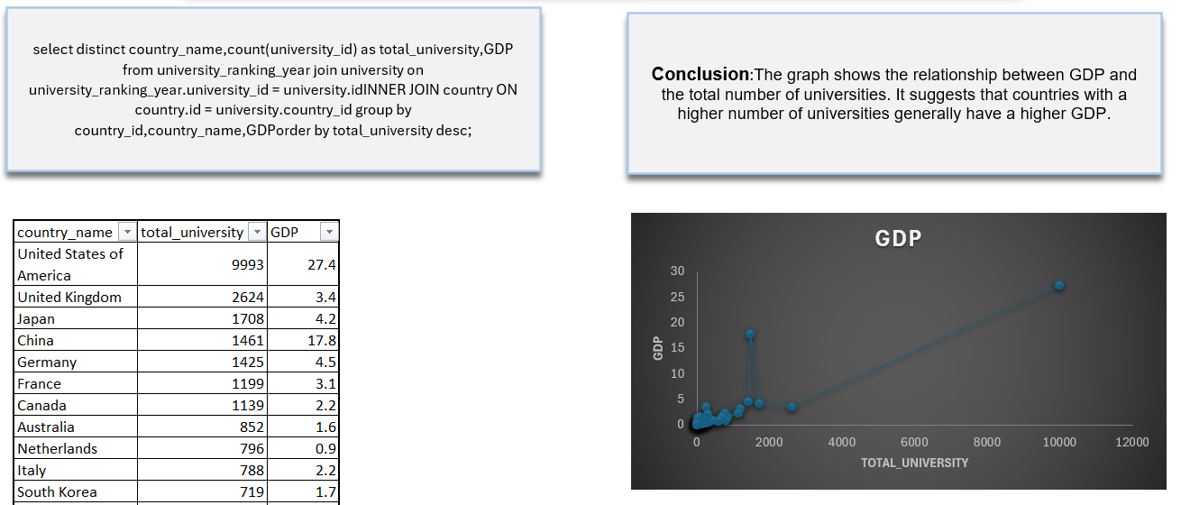
Is there a correlation between a country's GDP and the number of universities

Slide 31
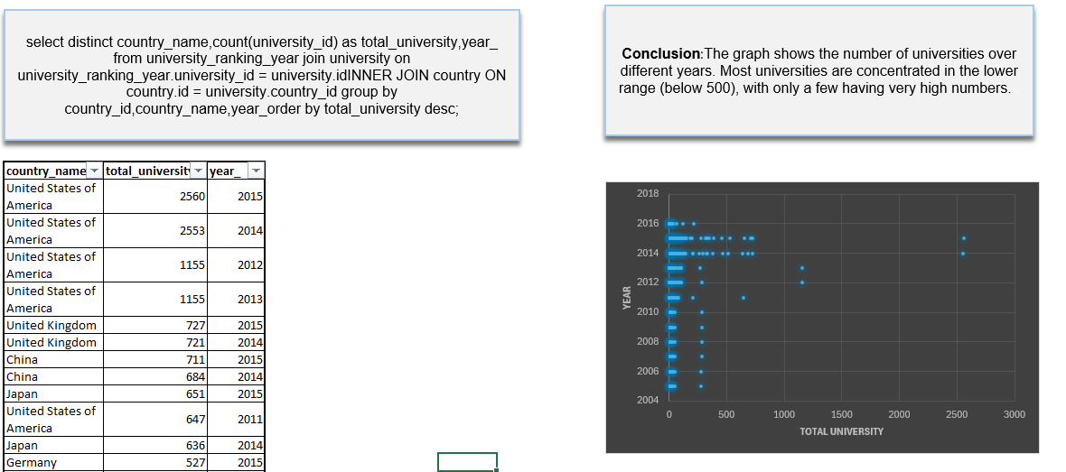
How has the number of universities changed over the years in each country

Slide 32
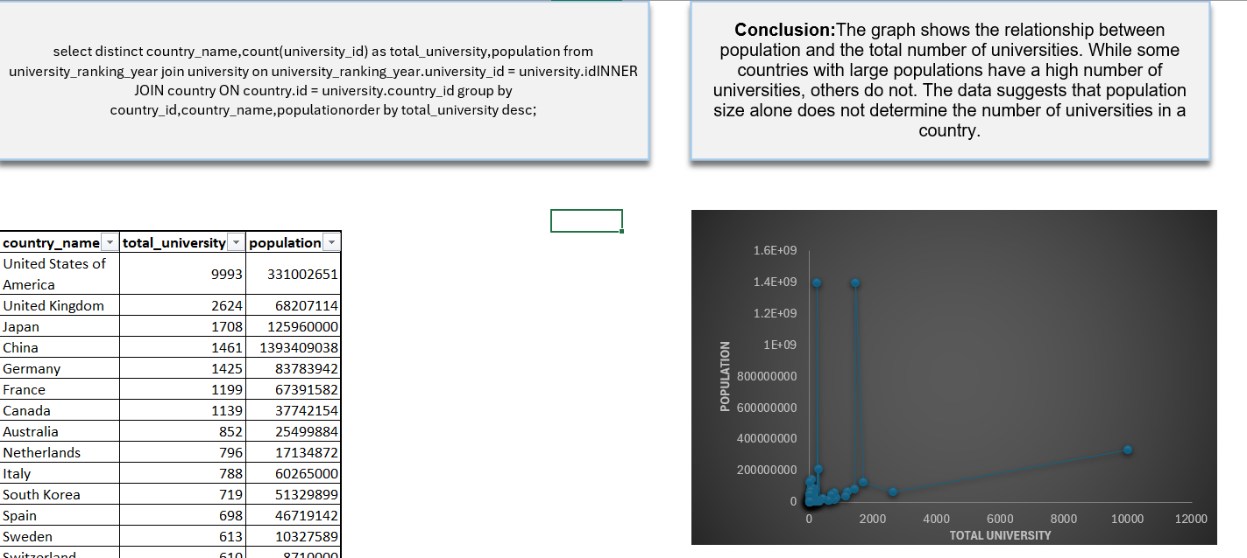
Is there a relationship between a country's population and the number of universities

Slide 33
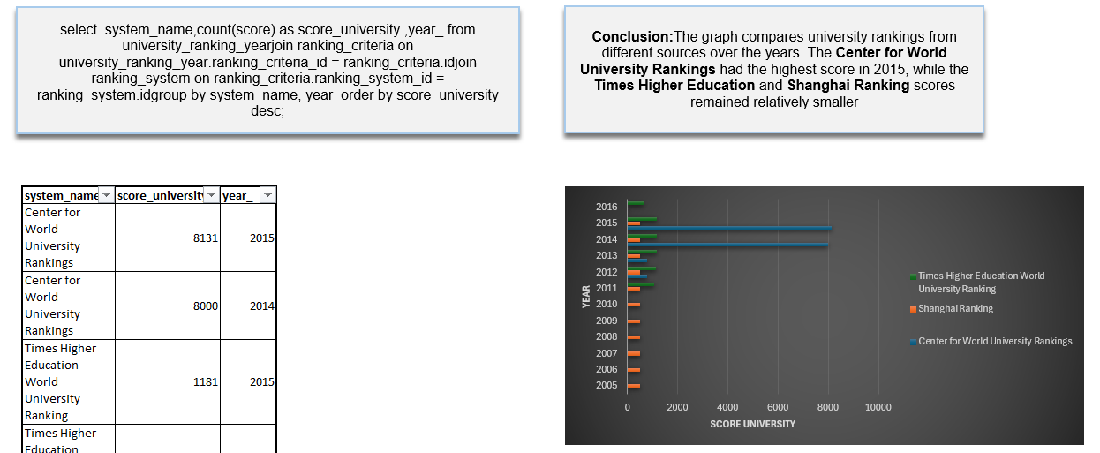
What is the trend in university rankings over the years according to each system

Slide 34
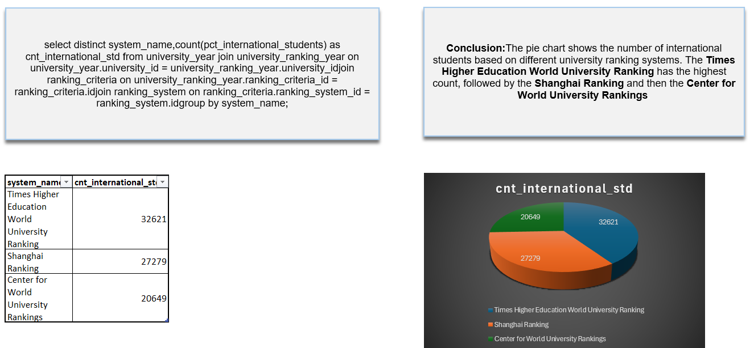
How does the choice of ranking system affect a university's international student enrollment

Slide 35
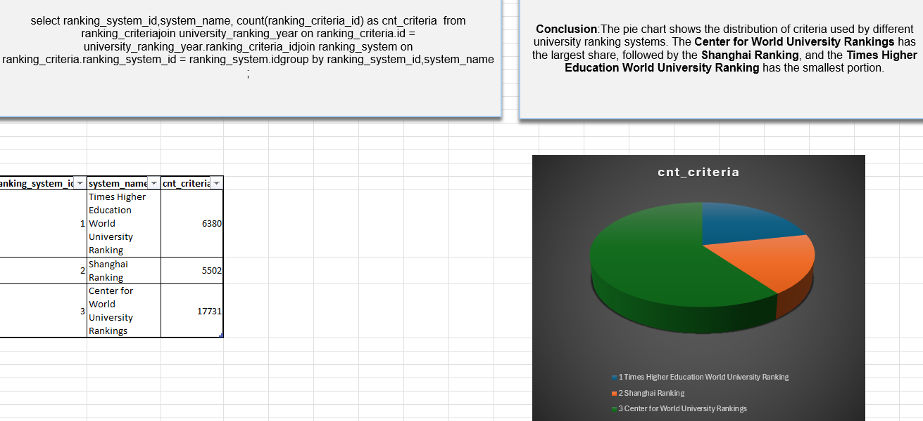
Are there any criteria that have different weights in different ranking systems

Slide 36
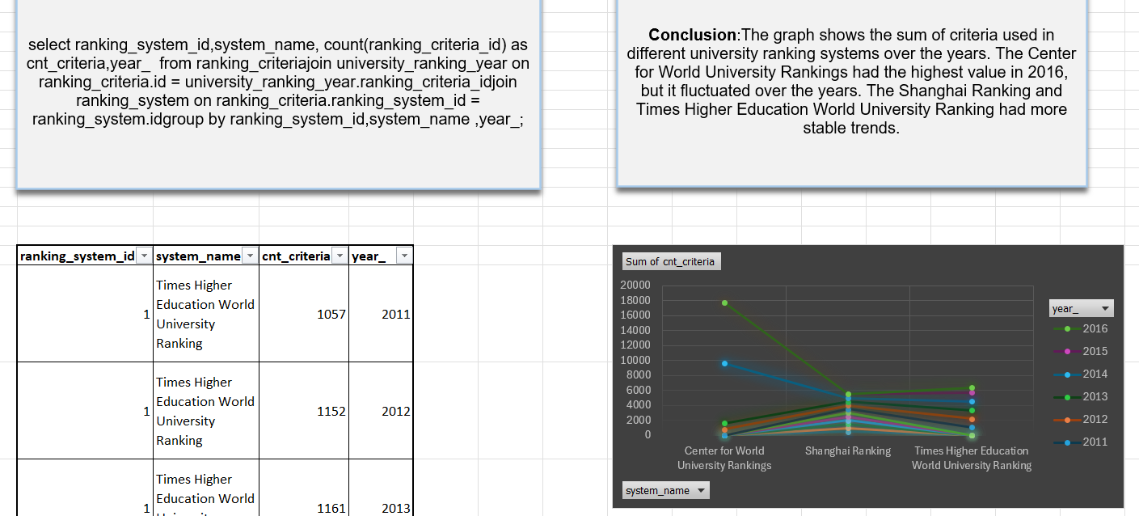
How have the weights of ranking criteria changed over time

Slide 37
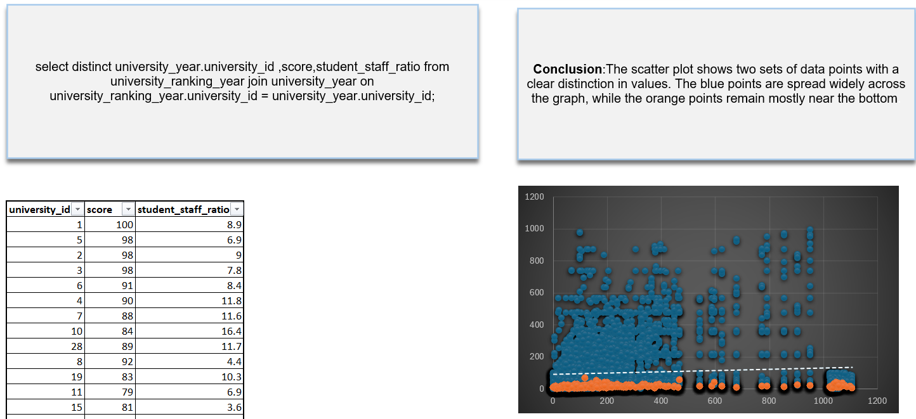
Is there a relationship between a university's score and the student-staff ratio

Slide 38
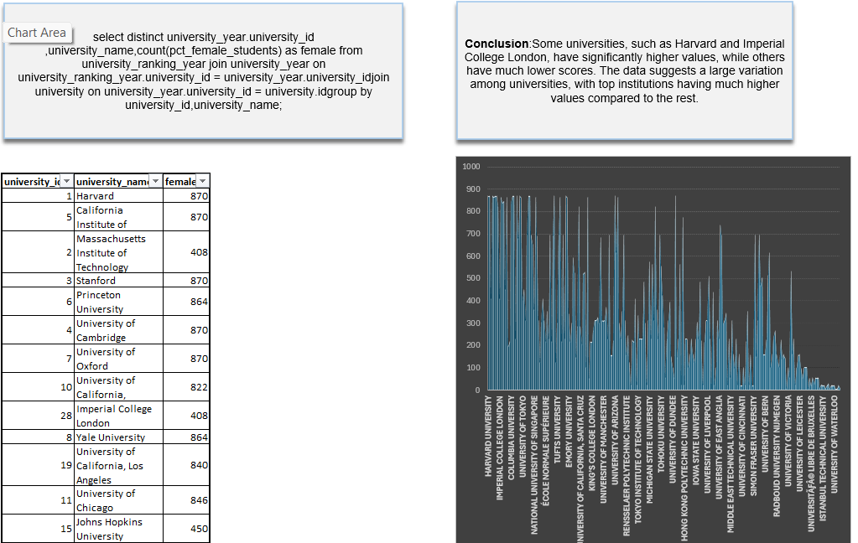
How does the number of female students differ among universities

Slide 39
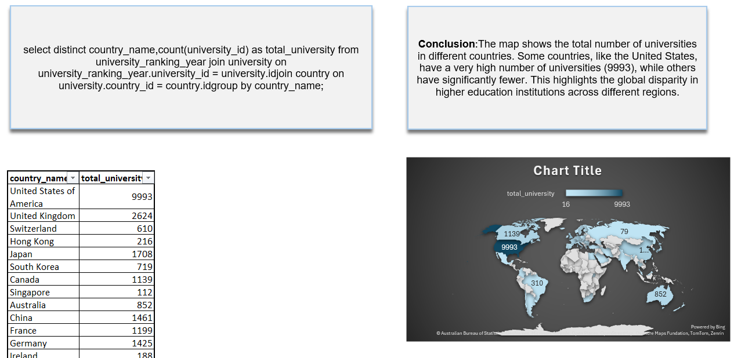
What is the distribution of universities across different countries

Slide 40
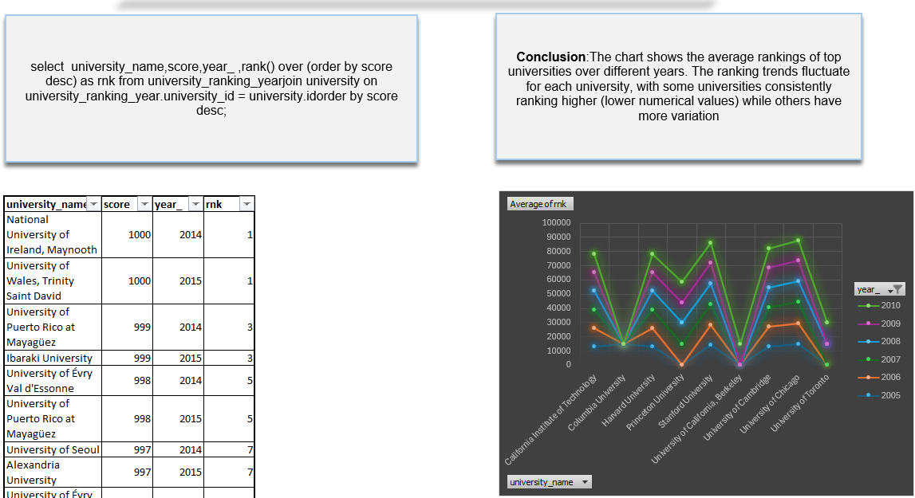
How has the ranking of universities changed over the years

Slide 41
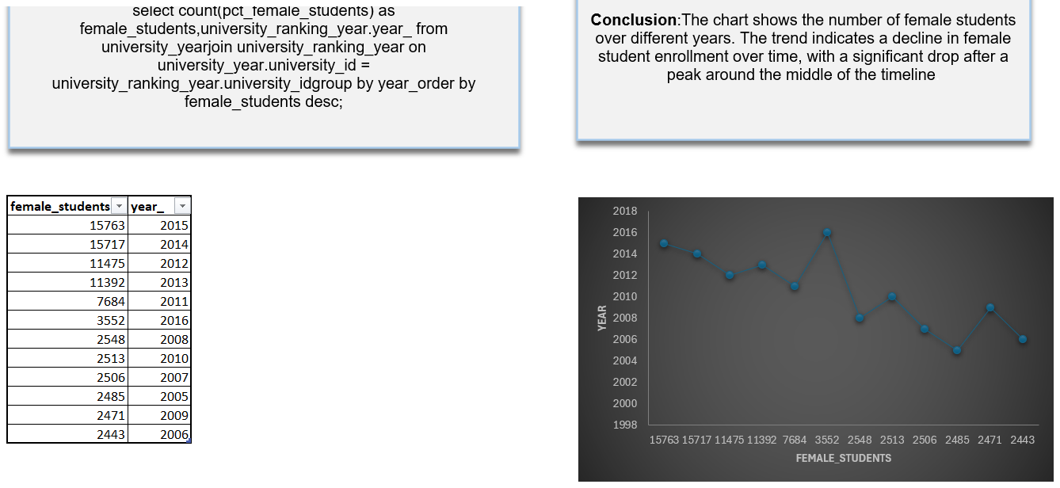
What is the trend in the percentage of female students over time

Slide 42
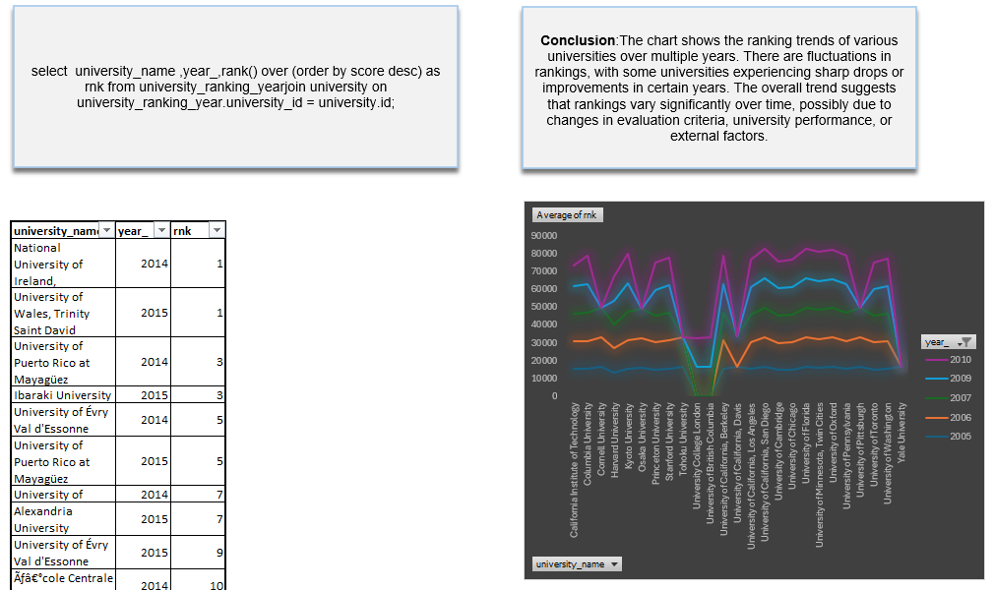
How has the ranking score of universities evolved over the years

Slide 43
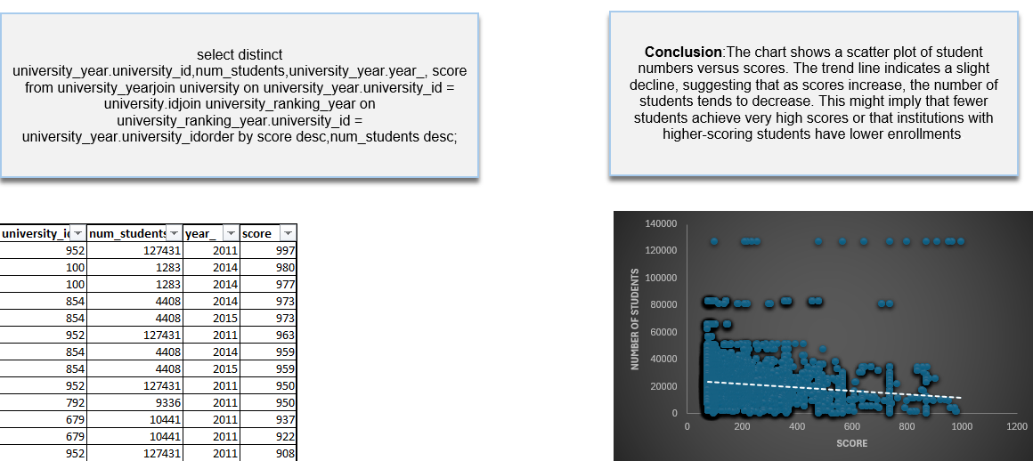
Is there a relationship between a university's ranking score and the number of students over time

Slide 44
THANK YOU
DONE BY AFREEN

